Slide 1

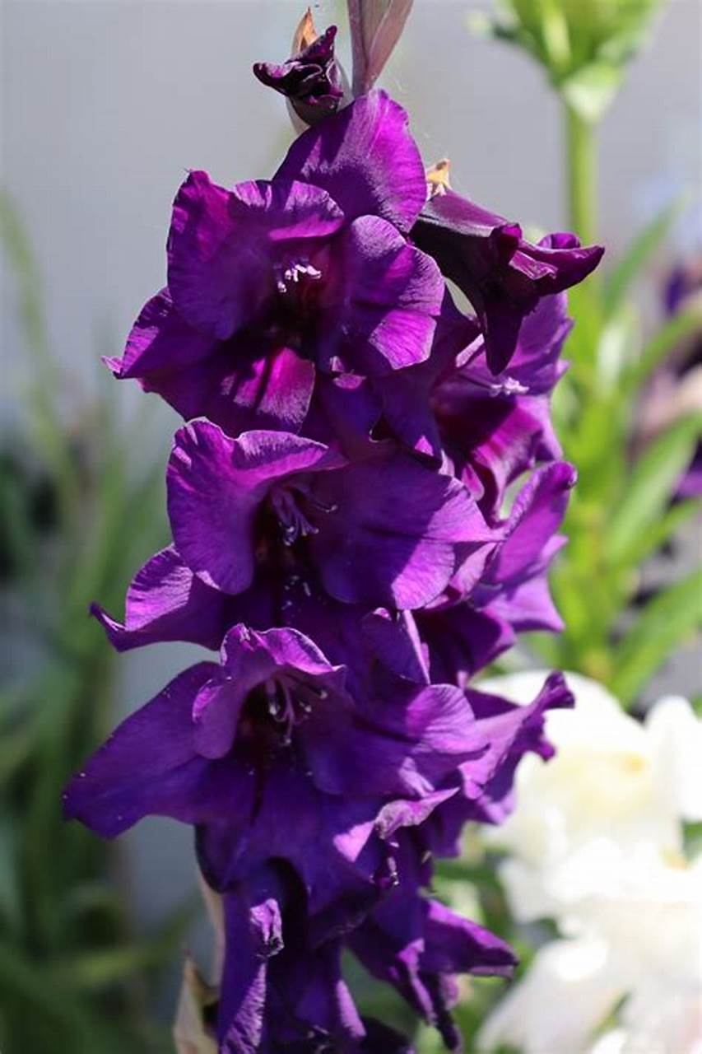
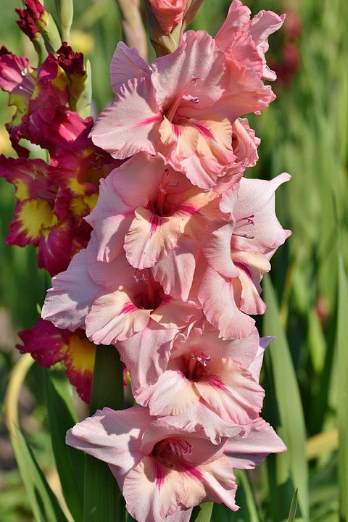
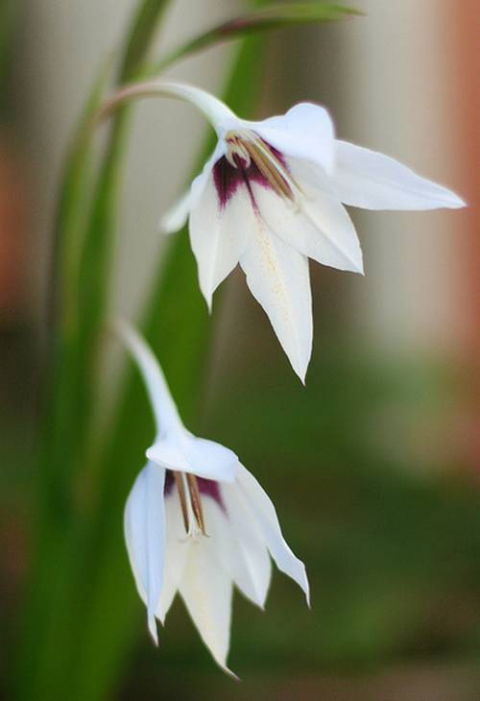
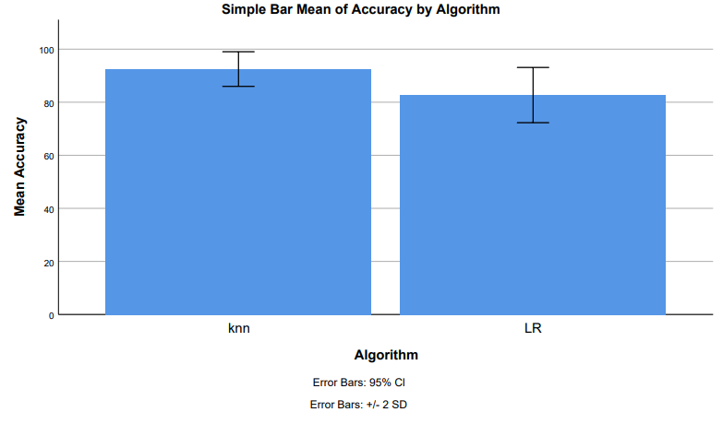
Name: V. Anil Kumar Yadav Register Number: 192110198
Guided by Dr M Rajasekar
Ms. Poorani.S
Guided by Dr. Mary Valantina. G
Classification of Sword lily Petal Features using K Nearest Neighbor with K Dimensional Tree and Logistic Regression Algorithm to Improve the Accuracy.
INTRODUCTION
The research aims to accurately classify different species of sword lilies (Gladiolus) and analyze their patterns.
Sword lilies hold significance due to their aesthetic appeal, economic value, and cultural importance in gardens, floristry, and ceremonies.
Sword lilies contribute to industries like horticulture, floristry, and pharmaceuticals, supporting livelihoods and trade.
They are used in ceremonies, celebrations, and rituals, symbolizing emotions and enriching traditions.
Sword lilies play a role in biodiversity conservation, environmental sustainability, and scientific research, making them valuable assets.
Sword lilies have applications in various industries and cultural practices, making them valuable and versatile plants.
Previous research has focused on accurately categorizing sword lily species using techniques like morphological analysis, genetic sequencing, and machine learning algorithms.
This paper aims to increase the accuracy rate in the classification of sword lilies using the K Nearest Neighbor algorithm with Logistic Regression, providing a reference for future researchers interested in species classification.
c
MATERIALS AND METHODS
Model Selection
Model Training
Model Evaluation
Data collection
Data processing
Feature Selection
Choose K Nearest Neighbor (KNN) with K Dimensional Tree and Logistic Regression algorithms for classification tasks.
Implement the KNN with K Dimensional Tree and Logistic Regression algorithms using appropriate libraries.
Train each model on the preprocessed dataset.
Evaluate the performance of the KNN and logistic regression models using metrics such as accuracy, precision, recall, F1-score, and confusion matrix
Obtain a dataset consisting of sword lily petal features, including measurements such as petal length, width, color, etc. This dataset should also include corresponding labels indicating the species of the sword lily.
Load the sword lily petal dataset.
Preprocess the data by handling missing values, scaling features, and encoding categorical variables if necessary.
Analyze the importance of features and select relevant ones for classification.
Perform feature engineering if needed to create new informative features.
KNN with K Dimensional Tree
Logistic Regression
Results Analysis
Implement the K Nearest Neighbor (KNN) algorithm, which classifies a sample based on the majority class of its k nearest neighbors
Implement logistic regression, a statistical model that uses logistic function to model the probability of a binary outcome.
Draw conclusions regarding the effectiveness of the KNN with K Dimensional Tree and logistic regression algorithms in classifying sword lily petal features
RESULTS
K Nearest Neighbor v/s Logistic Regression
K Nearest Neighbor has highest accuracy 92.50% when compared with the Accuracy of Logistic Regression 82.70%.
The standard deviation of K Nearest Neighbor Algorithm and Logistic Regression Algorithm are 3.269 and 5.202 respectively.
The standard error mean of K Nearest Neighbor Algorithm and Logistic regression Algorithm are 0.731 and 1.163 respectively.
These results that K Nearest Neighbor algorithm is best for these research of classification of Sword lily.
Group Statistics table 1
Independent sample table |  | Levene's test for equality of variances | T- test for equality of means
 |  |  |  |  |  |  |  |  | 95% confidence interval of the difference
 |  | F | Sig. | t | df | Sig. (2-tailed) | Mean difference | Std. Error difference | Lower | Upper
Accuracy | Equal variances assumed Equal variances not assumed | 9.572 | 0.004 | 7.133 | 38 | 0.032 | 9.800 | 1.374 | 7.019 | 12.581
 | Equal variances assumed Equal variances not assumed |  |  | 7.133 | 31.979 | 0.032 | 9.800 | 1.374 | 7.002 | 12.598
 | Algorithm | N | Mean | St. Deviation | Std.Error Mean
Accuracy | K Nearest Neighbor | 20 | 92.50 | 3.269 | 0.731
 | Logistic Regression | 20 | 82.70 | 5.202 | 1.163
Figure 2: The shown groups in the X-axis are the K Nearest Neighbor algorithm vs Logistic Regression Algorithm and the Y-axis mean accuracy of detection ± 2 standard deviations.
finding the accuracy of the two algorithms, the mean accuracy of K Nearest Neighbor is 92.05% better than the Logistic Regression 82.70% and St. Deviation is slightly lower than the Logistic Regression
DISCUSSION AND CONCLUSION
K Nearest Neighbor algorithm achieves 92.50% accuracy, outperforming Logistic Regression's 82.70% accuracy in classifying sword lilies based on the training dataset.
Independent tests reveal a statistically significant difference in accuracy between the two algorithms, with a p-value of 0.032 (p<0.05).
Various studies have evaluated supervised learning approaches for sword lily species prediction, including neuro-fuzzy approaches and machine learning-based classification methods.
Logistic Regression, despite its widespread use, faces limitations such as its inability to handle non-linear relationships between features and the target variable. It assumes a linear decision boundary, making it less effective in capturing complex patterns in data.
Logistic Regression is sensitive to outliers, which can skew model coefficients and predictions, affecting its performance.
Logistic Regression assumes independence among features, which may not hold true in real-world datasets, leading t o biased estimates and reduced predictive accuracy.
Logistic Regression is prone to overfitting, especially when the number of features is large compared to the number of observations. Regularization techniques can help mitigate this issue but may not always be sufficient.
K Nearest Neighbor algorithm does not require a training phase, relying on observable data similarities. It offers a sophisticated approach to classification tasks.
While Logistic Regression is valuable in classification tasks, its limitations should be considered, especially in scenarios where complex relationships exist among features or when dealing with large datasets.
BIBLIOGRAPHY
Shilpa Sethi, Mamta Kathuria, "Ensemble Feature Reduction Technique for Flower Species Identification", 2023 International Conference on Advanced Computing & Communication Technologies (ICACCTech), pp.721-728, 2023.
Anushee Jain, Chandrasekharan Rajendran, "A Novel Linear Mathematical Model Based Heuristic for a Class of Classification Problem with Non-linearly Separable Data", Applications of Emerging Technologies and AI/ML Algorithms, pp.247, 2022.
N. J. Anasuya, B. N. Yashasvi, P. Puneeth Kumar, B. S. Medha, "Classification of Flower Species Using Machine Learning Algorithm", Proceedings of the International Conference on Cognitive and Intelligent Computing, pp.699, 2022.
Abdullah Albadrani, Faisal Alghayadh, Mohamed A. Zohdy, Esam Aloufi, Richard Olawoyin, "Performance and Predicting of Inbound Logistics Processes Using Machine Learning", 2021 IEEE 11th Annual Computing and Communication Workshop and Conference (CCWC), pp.0790-0795, 2021.
Mohri, Hideo. 2019. Imperial Biologists: The Imperial Family of Japan and Their Contributions to Biological Research. Springer
Preisach, Christine, Hans Burkhardt, Lars Schmidt-Thieme, and Reinhold Decker. 2008. Data Analysis, Machine Learning and Applications: Proceedings of the 31st Annual Conference of the Gesellschaft Für Klassifikation e.V., Albert-Ludwigs-Universität Freiburg, March 7-9, 2007. Springer Science & Business Media.

